Slide 1


HOW TO INSTALL
SUBLIME TEXT 3?
Jurusan Teknologi Informasi
Prodi D-IV Teknik Informatika

Slide 2

Member of Group 8 :
Mochammad Syaifuddin Zuhri (17)
Arlan Ady Pratama (5)
Sesha Dwi Lestari (27)
Lecturer Name :
Ibu Atiqah Nurul Asri, S.Pd., M.Pd.

Slide 3

What Is
SUBLIME
TEXT 3?

Slide 4
SUBLIME TEXT
Sublime Text supports various programming languages
and is able to present syntax highlight features in
almost all programming languages that are
supported or developed by the community
such as; C ++, HTML, Java, PHP, Python, etc.

Slide 5
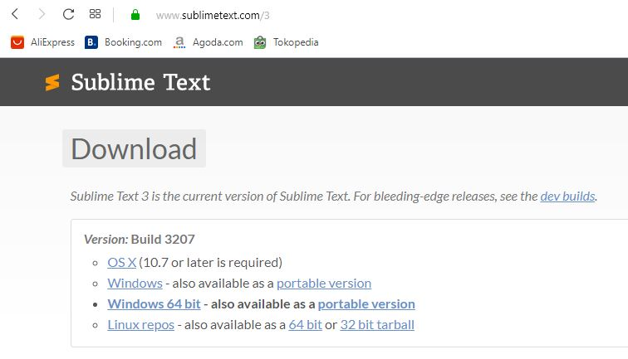
STEP 1 :
First, download file at this link. https://www.sublimetext.com/3

Slide 6
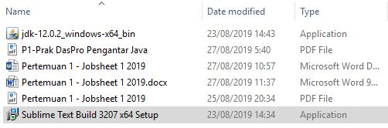
STEP 2 :
after the download is complete then open the file.

Slide 7
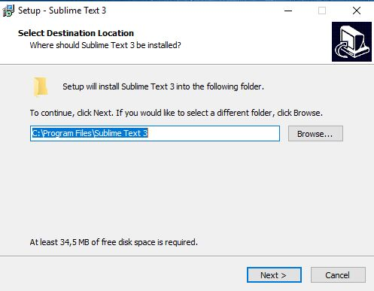
STEP 3 :
Then, Custom installation Folder
do You Want.
1
2

Slide 8
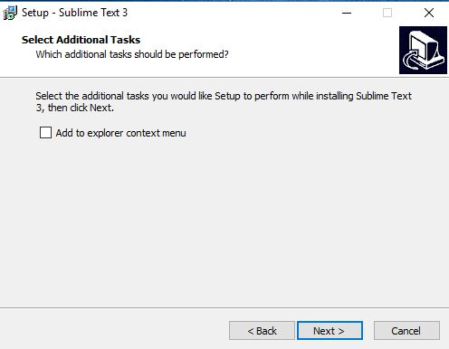
STEP 4 :
Then, You Can Choose Want/Not
Add To Explorer context menu.

Slide 9
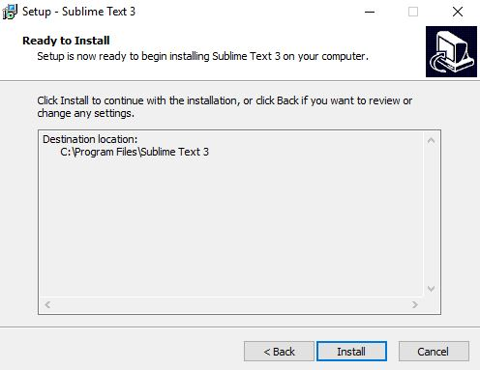
STEP 5 :
After that, Install the program.

Slide 10
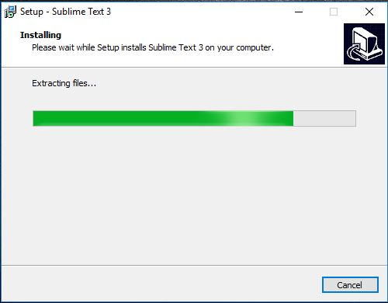
STEP 6 :
Wait a few minutes for the
installation to complete

Slide 11
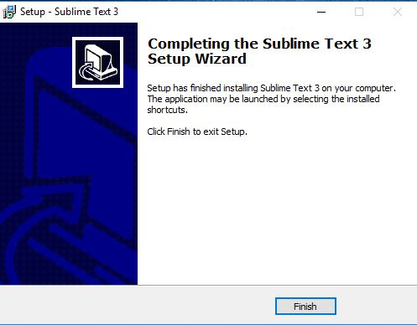
STEP 7 :
After that, the installation is
Complete.

Slide 12
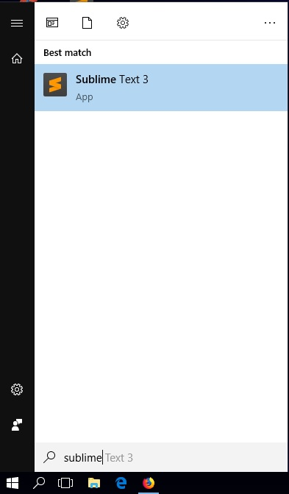
Then,
Open the sublime text program.

Slide 13
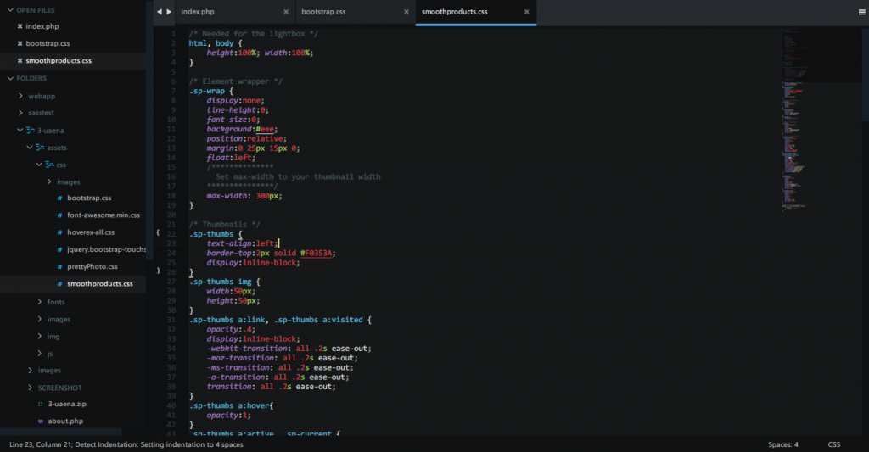
sublime text program display

Slide 14
That's all from
our presentation
THANK YOU

